Slide 1
Pink Eye Detection Using Machine Learning
Team Id : CU_CP_Team_21
College Name : Sigma Institute of Engineering
Members : Patel Vraj Hemangkumar , Patel Ansh Satishbhai , Patel Aksh Hemantkumar , Padariya Jagrutkumar Kaushikbhai

Slide 2
AGENDA
Dataset Acquisition and Preparation:
Gather a diverse dataset of images containing examples of normal eyes and eyes affected by pink eye.
Pre-process the dataset to ensure consistency in size, resolution, and quality.
Augment the dataset to enhance its diversity and robustness.
Model Development and Training:
Design and develop a machine learning model using appropriate algorithms such as convolutional neural networks (CNNs).
Train the model on the pre-processed dataset to accurately distinguish between normal and pink eye cases.
Experiment with different architectures and hyperparameters to optimize the model's performance.
Evaluation and Validation:
Evaluate the trained model using appropriate metrics such as accuracy, precision, recall, and F1-score on a separate test dataset.
Perform cross-validation to assess the model's performance across different types and severities of pink eye.
Validate the model's effectiveness in early detection and classification of pink eye cases.
Deployment and Integration:
Deploy the trained model into a user-friendly application or platform for healthcare professionals.
Integrate the pink eye detection system with existing healthcare systems to ensure seamless workflow integration.

Slide 3
PROBLEM STATEMENT
Pink eye, or conjunctivitis, is a common eye condition characterized by inflammation and redness of the conjunctiva, the transparent membrane that covers the white part of the eyeball and lines the inner surface of the eyelids. It can be caused by various factors such as viral or bacterial infections, allergies, or irritants. Early detection and treatment of pink eye are crucial to prevent its spread and to provide timely medical intervention.

Slide 4
PROJECT OVERVIEW
The aim of this project is to develop a machine learning model capable of accurately detecting the presence of pink eye in images of human eyes. This model will assist healthcare professionals in quickly identifying cases of pink eye, especially in scenarios where access to specialized ophthalmologists may be limited.

Slide 5
THE WOW FACTOR IN OUR SOLUTION
Early Detection and Intervention: By harnessing the power of machine learning, this project offers the potential to detect pink eye at an early stage, even before noticeable symptoms manifest fully.
Accessibility and Convenience: The automated nature of the pink eye detection system makes it highly accessible to healthcare professionals across various settings, including remote and underserved areas where access to specialized eye care may be limited. This accessibility enhances the reach of healthcare services and promotes timely diagnosis and treatment.
Accuracy and Efficiency: The machine learning model developed in this project aims to achieve high accuracy in distinguishing between normal eyes and those affected by pink eye. By providing accurate and reliable results, the system enhances the efficiency of healthcare professionals, enabling them to prioritize cases requiring immediate attention while reducing unnecessary consultations.
integration with Healthcare Systems: The seamless integration of the pink eye detection model with existing healthcare systems ensures smooth workflow integration for healthcare professionals. This integration facilitates easy access to the system's functionalities within their existing workflow, promoting adoption and utilization.
Continuous Improvement and Adaptation: The project's emphasis on continuous monitoring, feedback collection, and model refinement ensures that the system evolves over time to address emerging challenges and variations in pink eye cases. This adaptability enhances the system's effectiveness and relevance in real-world healthcare settings.

Slide 6
MODELLING
CNN
For the Pink Eye Detection project, a Convolutional Neural Network (CNN) is commonly used as the model in deep learning. CNNs are particularly well-suited for image classification tasks like this one due to their ability to effectively learn spatial hierarchies of features directly from the image data.

Slide 7
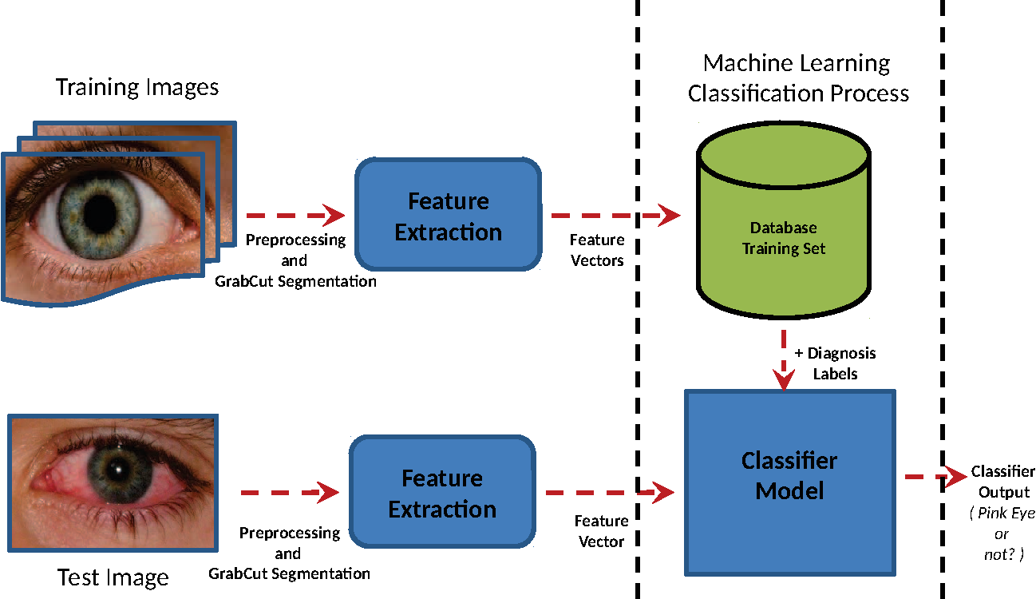
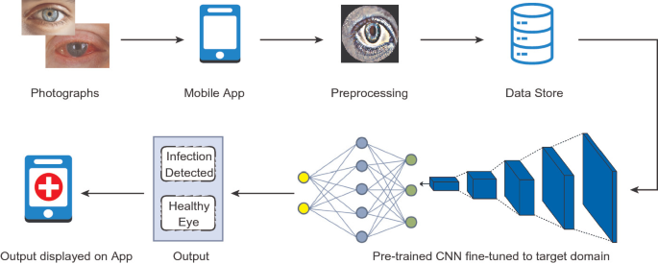
Working

Slide 8
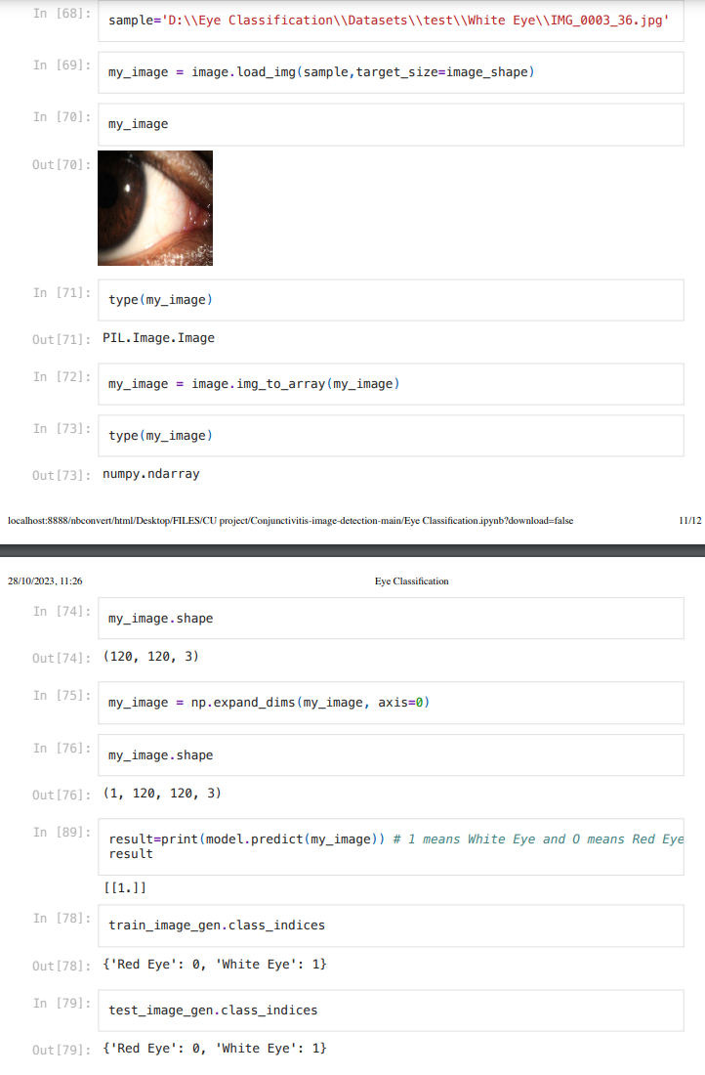
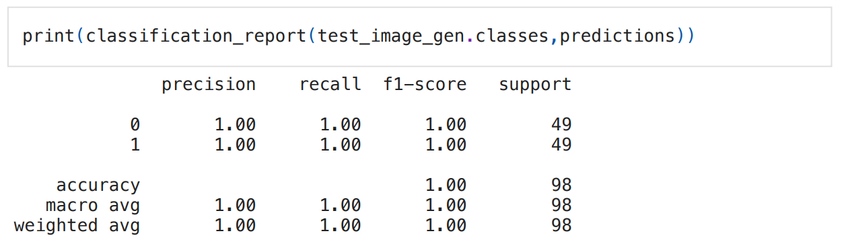
RESULTS

Slide 9
CONCLUSION
The Pink Eye Detection project demonstrates the feasibility and effectiveness of using machine learning, specifically convolutional neural networks (CNNs), for automated detection of pink eye in human eye images. Through meticulous dataset curation, pre-processing, model development, and evaluation, the project has achieved significant strides towards addressing the challenge of early identification and intervention in cases of conjunctivitis.
Important links:
Project DEMO : https://github.com/OfficialAkshPatel/Conjunctivitis-image-detection-Using-Machine-Learning

Slide 10




MEET OUR TEAM
Patel Vraj
Patel Aksh
Patel Ansh
Padariya Jagrut

